Slide 1
Python 爬蟲

Slide 2
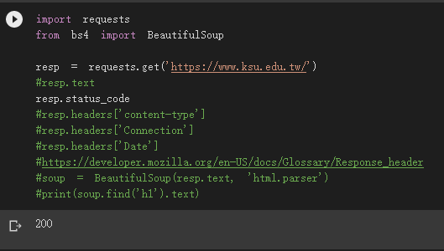

Slide 3
import requests
from bs4 import BeautifulSoup
resp = requests.get('https://www.ksu.edu.tw/')
#resp.text
resp.status_code
#resp.headers['content-type']
#resp.headers['Connection']
#resp.headers['Date']
#https://developer.mozilla.org/en-US/docs/Glossary/Response_header
#soup = BeautifulSoup(resp.text, 'html.parser')
#print(soup.find('h1').text)
顯示網站是否有正常啟動如果沒有會顯示404
顯示使用語言
如果發送的值為 keep-alive，則連接是持久的且未關閉
顯示使用的當下時間
顯示h1標頭的字

Slide 4
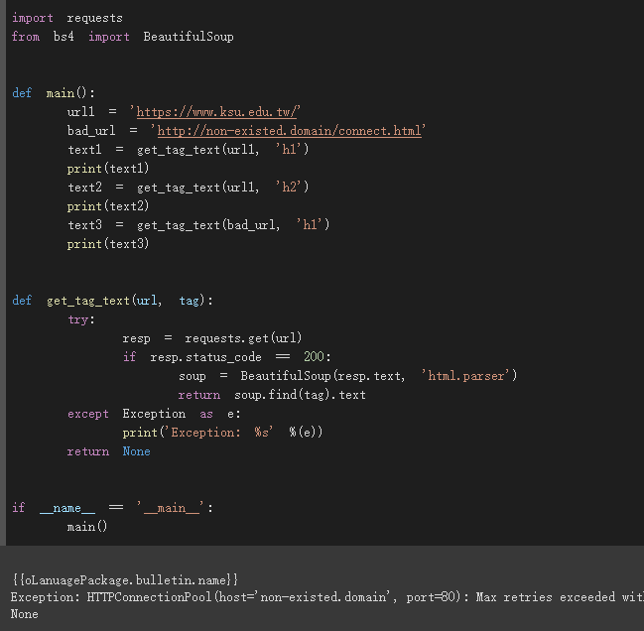

Slide 5
import requests
from bs4 import BeautifulSoup
def main():
url1 = 'https://www.ksu.edu.tw/'
bad_url = 'http://non-existed.domain/connect.html'
text1 = get_tag_text(url1, 'h1')
print(text1)
text2 = get_tag_text(url1, 'h2')
print(text2)
text3 = get_tag_text(bad_url, 'h1')
print(text3)
def get_tag_text(url, tag):
try:
resp = requests.get(url)
if resp.status_code == 200:
soup = BeautifulSoup(resp.text, 'html.parser')
return soup.find(tag).text
except Exception as e:
print('Exception: %s' %(e))
return None
if __name__ == '__main__':
main()

